Slide 1
Risk factors for CoVid-pandemic
Dataintegration Project Deniz & Yannik

Slide 2
Data from John-Hopkins-University
Monitored all corona cases and deaths worldwide (January 2020 – March 2023)
Partitioned by date (timeseries) and country
CSV-file
Source (Raw data): https://github.com/CSSEGISandData/COVID-19/tree/master/csse_covid_19_data

Slide 3
Data from OECD
Facts about health-care-system in countries worldwide
Time series (values per year)
Example: Number of hospitals, hospital beds, nurses, healthcare workers,…
Can provide relative numbers (per million citizens)
CSV file
Source: https://stats.oecd.org/index.aspx?ThemeTreeId=9

Slide 4
Showcase
Find correlation between quality of health care system and deaths by covid pandemic
Bring geographical values into play to find similarities between geographical neighbours, etc.

Slide 5
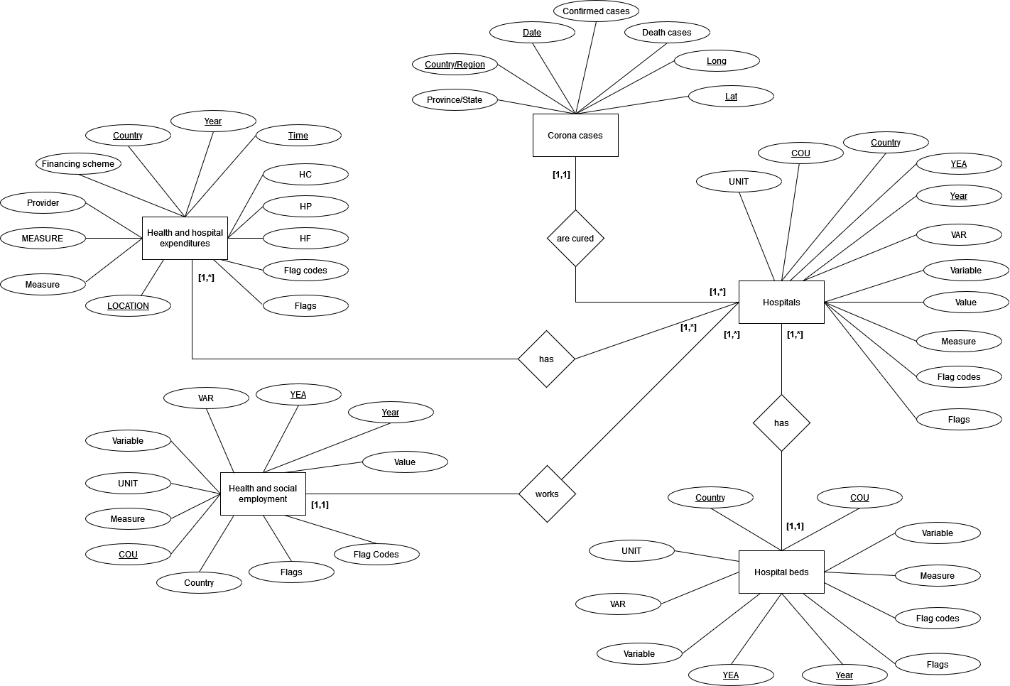
Entity-Relationship

Slide 6
Problem
Not that much data integration needed
Basically just a join of two data sets by a primary key (country name)
No exciting results expected (indeed, we expect to find high correlations)
In fact, only one entity, no or only few relationsships

